Slide 1
Rice Data Science Bootcamp
Instructor: Natalie Berestovsky, PhD
Occidental Petroleum/
Anadarko Petroleum

Slide 2
Your instructor
Education
  BS in Computer Science from UT-Austin
  MS and PhD in Computer Science from Rice
Professional Experience:
  Worked in Chevron for 6 years in Chevron
  Data Scientist in Anadarko for 2.5 years
  Next: Oxy?
AI experience:
  ML techniques, deep learning
  Google Cloud Platform

Slide 3
Data Science
Notes:
Data science

Slide 4
Supervised vs unsupervised
Supervised / Unsupervised / Both
  Recognizing digits in the images (S)
  Gene clustering (U)
  Identifying alerts in your streaming data (B)
  Predicting stock prices (B)
  Anomaly / fraud detection (B)
  Ranking public speech impact from recordings (U)
  Face recognition (S)
  Automated text completion (Gmail) (S)
  Voice recognition (S)

Slide 5
Supervised vs unsupervised
p 1
n
Supervised
Unsupervised

Slide 6
Data Dimensions
n >> p
More samples than features
Examples?
n << p
Fewer samples than features
Examples?
p 1
p 1
n
n

Slide 7
Modeling methodology
p 1
Train
Test
(5-20%)
Train / test split
  Hold out validation
    Selects x% of data randomly
  K-fold cross validation
    Shuffles that data (or not)
    Split the data into k equal sets
    For each split, use k-1 set for training and test on the k^{th}
n

Slide 8
Assessing your model
p 1
Training error
  Error of how well the model generates the data that it has seen
Testing error
  Error on unseen data (prediction)
Generally E_{train} <= E_{test}
What if E_{train} << E_{test} ?
What if E_{train} > E_{test} ?
Training
Error
Testing
Error
n

Slide 9
Overfitting and underfitting
Bias – difference between predicted and true value
  High bias – generalized model, high error
  Low bias – fits well to the training set, low training error
Variance – variability of prediction for a given data point
  High variance – sensitive to training data set
  Low variance – not sensitive to changes in training set
Irreducible error – noise in the data
Notes:
Ref: https://towardsdatascience.com/understanding-the-bias-variance-tradeoff-165e6942b229

Slide 10
Overfitting and underfitting
Bias-variance tradeoff
  Complex, many parameters
    overfitting
  Simple, few parameters
    underfitting
Notes:
Ref: https://towardsdatascience.com/understanding-the-bias-variance-tradeoff-165e6942b229

Slide 11
Supervised vs unsupervised
 | Supervised | Unsupervised
Discrete | Classification | Clustering
 | KNN Datasets: Wine dataset | K-Means Hierarchical clustering (Biclustering) Datasets: Synthetic data NCI60
Continuous | Regression | Dimensionality reduction
 | Multilinear regression Ridge regression Lasso regression Datasets: Boston housing dataset Synthetic data | Principle Component Analysis (PCA) Datasets: Art data NCI60
Notes:
https://idyll.pub/post/dimensionality-reduction-293e465c2a3443e8941b016d/

Slide 12
K Nearest Neighbors

Slide 13
K Nearest Neighbors

Slide 14
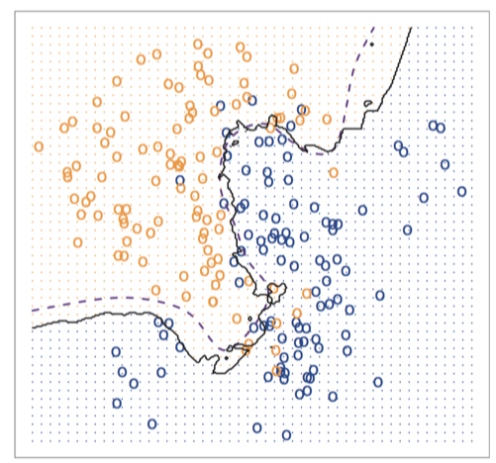
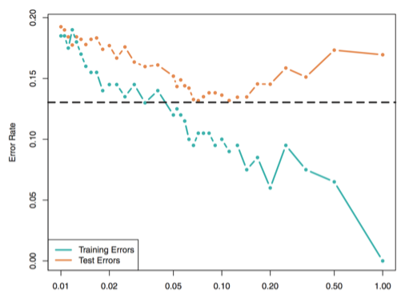
K Nearest Neighbors

Slide 15
Linear regression

Slide 16
Remember overfitting?
Solution:
  Feature selection
    Best subset regression, Forward and backward step-wise
  Regularized linear regression
    Ridge regression, Lasso regression

Slide 17
Ridge and Lasso regressions
Ridge
  It shrinks the parameters, therefore it is mostly used to prevent multicollinearity.
  L2 makes weights small
Lasso
  Used when we have more number of features, because it automatically does feature selection.
  L1 removes weights

Slide 18
Ridge and Lasso regressions
Force 1: Bias term pulling β1 and β2 to lie somewhere on the black circle only.
Force 2: Gradient Descent trying to travel to the global minimum indicated by the dots.
Each gradient descent contour corresponds to different LR
The RED circle in each contour intersects the Ridge or L2 Norm.
The BLACK circle in each contour intersects the Lasso or L1 Norm.
Notes:
Reference: https://towardsdatascience.com/regularization-in-machine-learning-connecting-the-dots-c6e030bfaddd

